Slide 1

Lets Draw!

Slide 2

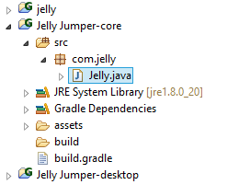
Structure
Before we get decide what our game will be,
lets understand what is happening in the background
Open your core project (Not Desktop Project)

Slide 3
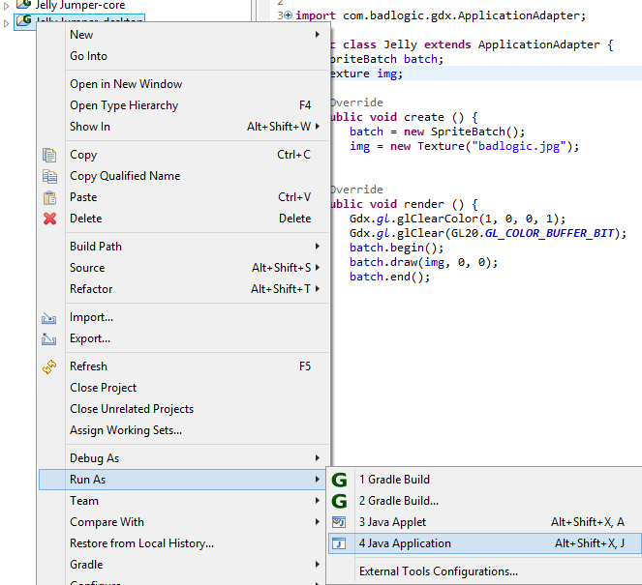
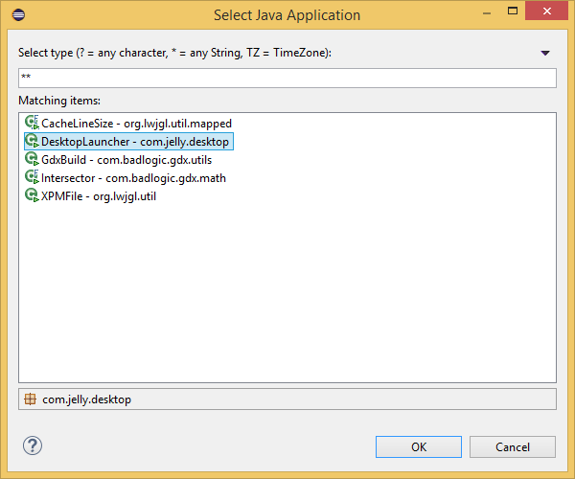
Test Run
Right click your desktop project, then select “Run As” > “Java Application” > “Desktop Launcher”

Slide 4
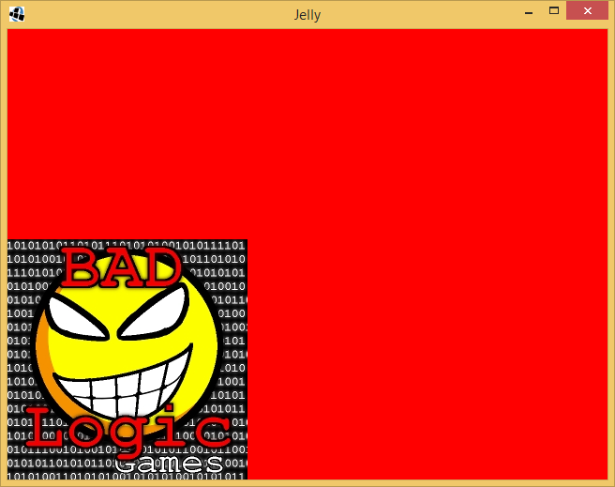
Test Run
Note two things:
Red Background
Image
Lets see how this works...

Slide 5
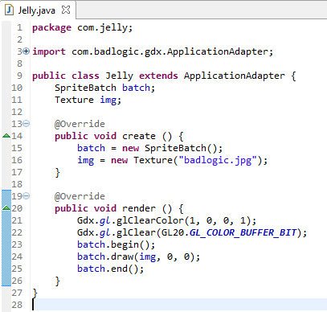
Spritebatch

Slide 6
Spritebatch
Picture
Red Background
glClearColor takes 4
arguments:
Red: (0.0 to 1.0)
Green: (0.0 to 1.0)
Blue (0.0 to 1.0)
Alpha (0.0 to 1.0)
*Alpha is transparency

Slide 7
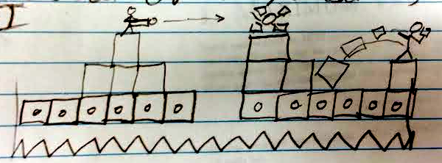
Our Game Idea
Tile Based Shooter
Jump on blocks, shoot blocks
Don’t fall on spikes

Slide 8
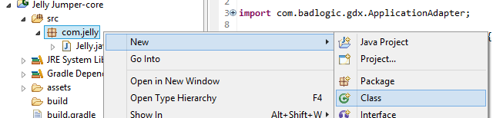

Character
Lets make a “Character” Object

Slide 9
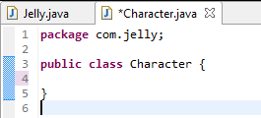
Character
What “Properties” will a character have?

Slide 10
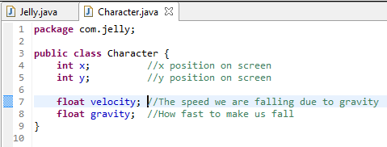
Character
What “Properties” will a character have?
Now, lets make a constructor for our character

Slide 11
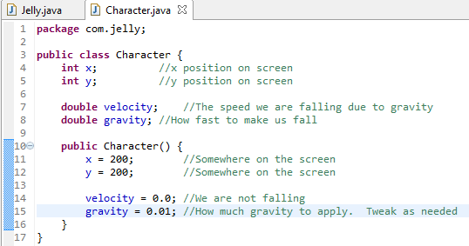
Character

Slide 12
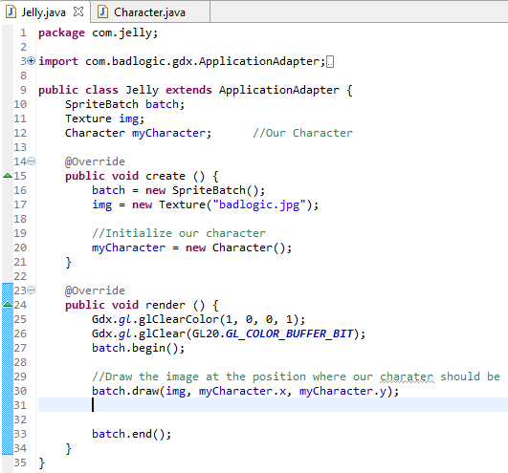
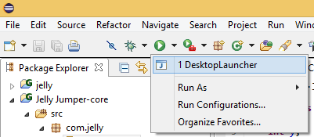
Character
Lets add our character to our main program
Lets test it out...

Slide 13
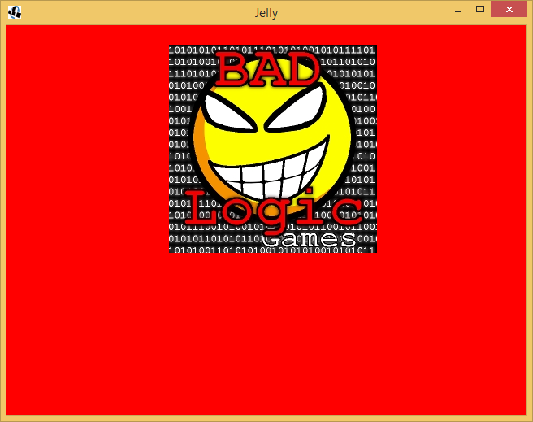
Character

Slide 14

Character
y
200
200
(0,0)
x

Slide 15
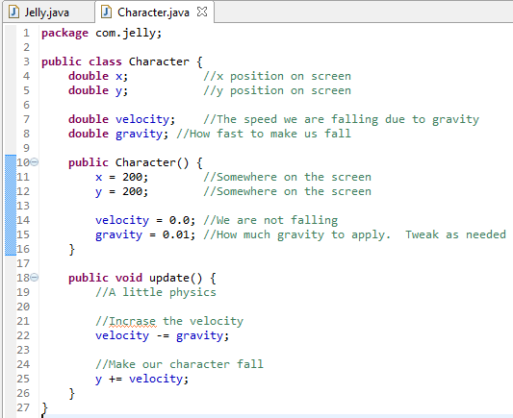
Gravity
Time to add gravity
Hopefully you understand some simple physics
Create a method called update()
This will be run every time the screen updates
NOTE: I changed x and y from ints to doubles.
You also have to make this change in the main file:

Slide 16
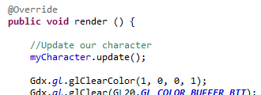
Gravity
Update our render method in our main file.
So update() gets called every time the screen updates
Lets Try it out!

Slide 17
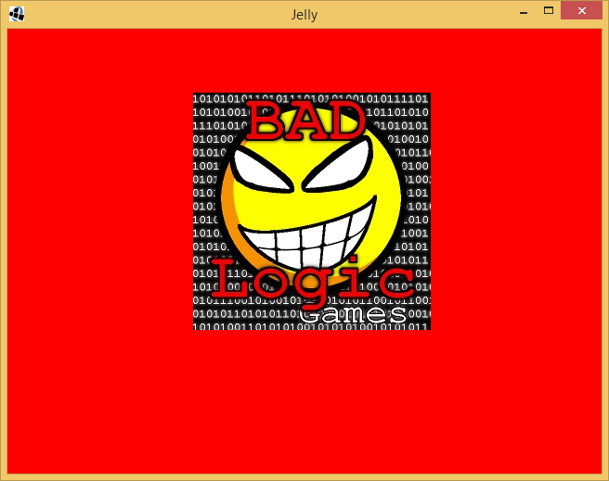
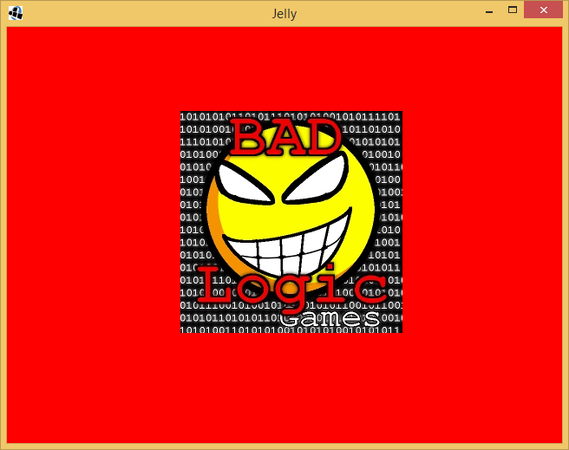
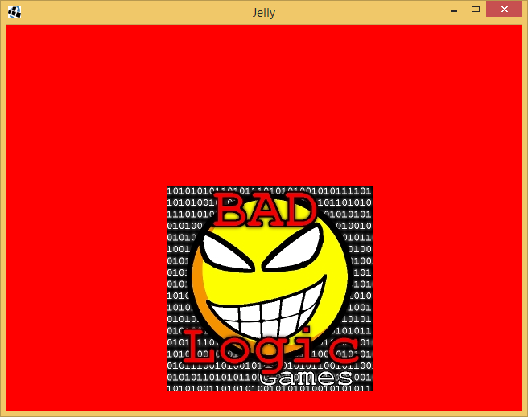
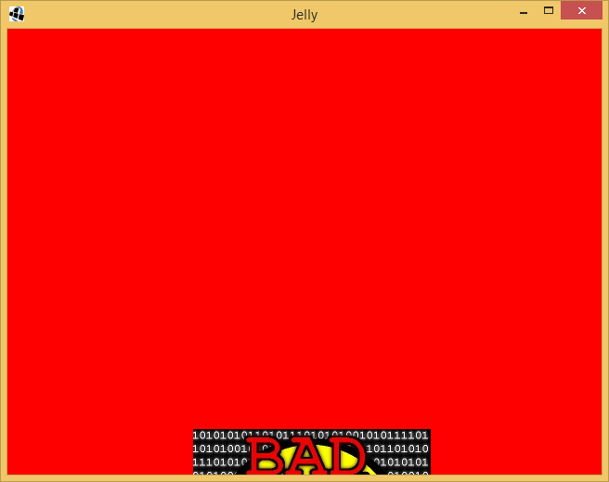
Gravity
Now, tweak the gravity in Character.java until it seems to fall realistically

Slide 18
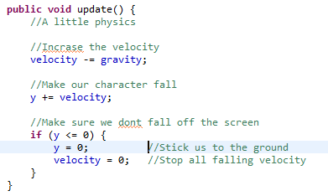
Ground
Almost done!
We don’t want our character to fall off the screen...

Slide 19
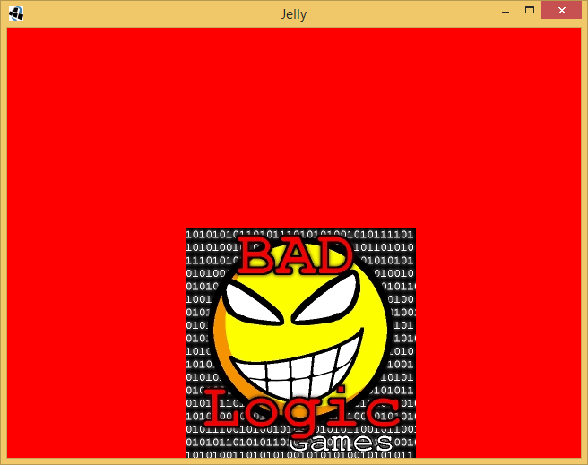
Gravity
HE STOPS!

Slide 20
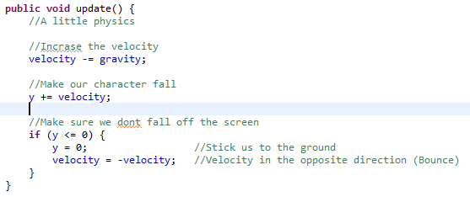
Ground
Have some fun, try this out!

